Slide 1
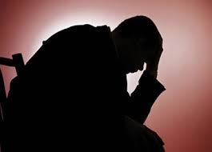
Depression Diagnosis from Speech
Chan Jun Wei
A0112084U
Advisor: Prof Ooi Wei Tsang
Notes:
Hi everyone, my name is Jun Wei. My FYP topic is about diagnosing depression using speech. As shown in the photo, depression has huge impact to our life.

Slide 2


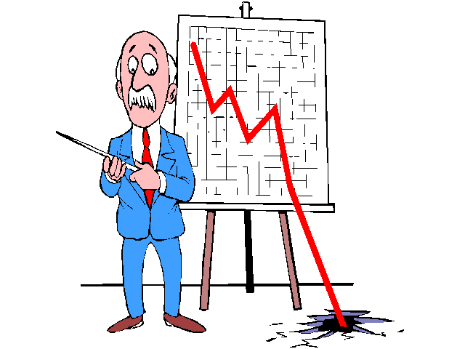

Problem
1
Notes:
It is a type of mental illness that has a negative impact on individuals’ quality of life, in either short or long period of time. The aﬀected individuals range from youth to elderly.
And who knows, maybe in NUS, there are a lot of people are facing depression due to exams and projects too!
Not only depression will cause lost productivity, but also suicide.
Depression is also one of the economic burdens in the world.

Slide 3

Problem
2
Depression is one of the most under-diagnosed illnesses even though it is one of the most treatable mental illnesses.
Reason:
Unwilling to seek help
Hide their feelings
Lack of objective measure
Notes:
Depression is one of the most under-diagnosed illnesses even though it is one of the most treatable mental illnesses.
In general health-care, 48.4% of patients suﬀering from depression are unrecognized.
Why is depression so hard to diagnosed? The key reason is they are not willing to seek help. In their opinions, being depressed implies that
they are being weak and depression is a personality defect. They are ashamed of it, trying to hide their feelings in order to live normal.
On the other hand, if they really try to seek help, the current measures such as the questionnaires are not objective enough because one tends to improve the aspect
of his behavior when he is being observed.

Slide 4
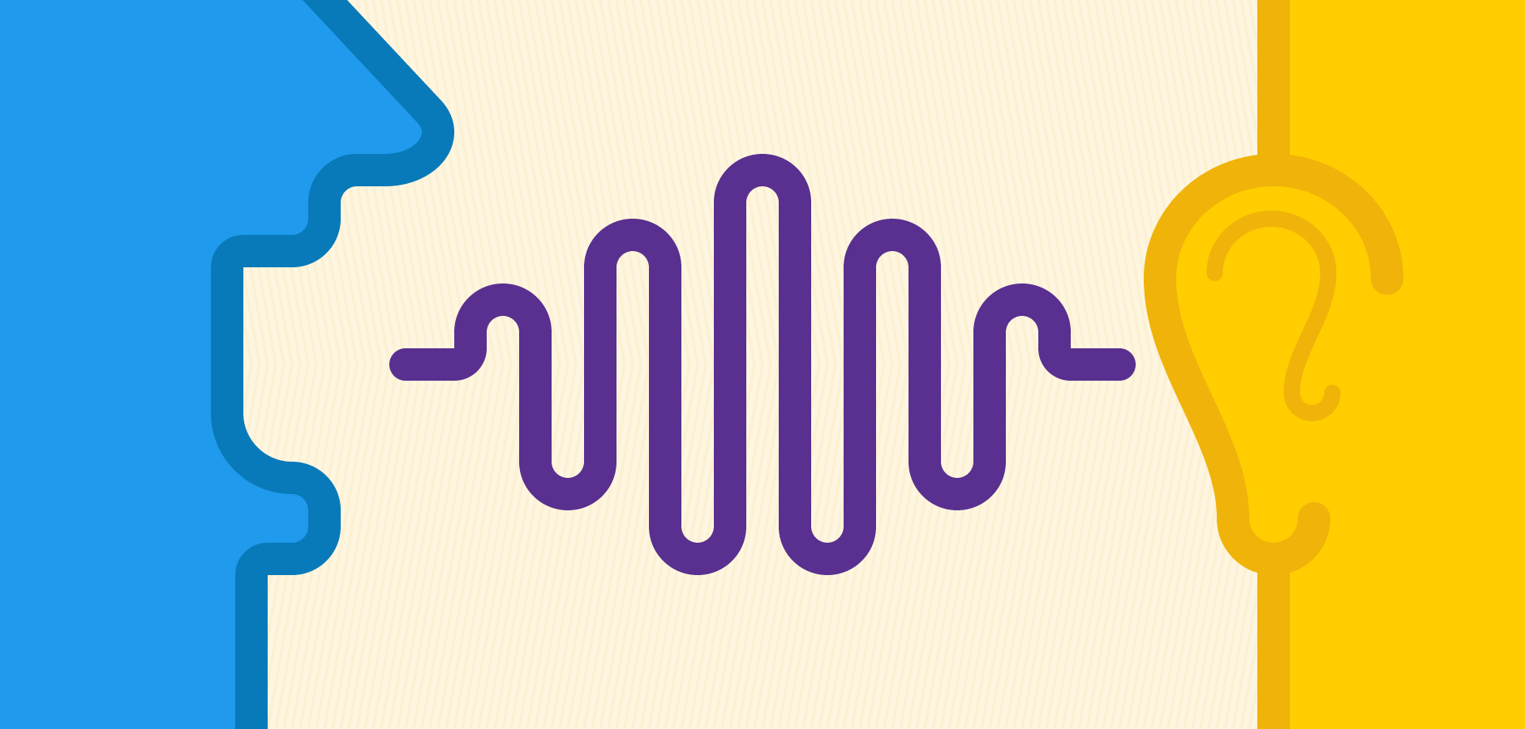
Idea
3
Diagnose depression using speech
“Diminished, prosodic and monotonous speech always has a strong co-relationship with depression.”
We hope to accurately detect depression from speech.
Notes:
Our solution is to diagnose depression using speech. It is proven that diminished, prosodic and monotonous speech always has a strong co-relationship with depression.
This also suggests that every depressed individuals actually have a similar speech signal, and this is an important assumption in this project.

Slide 5
Audio/Visual Emotion Challenge and Workshop (AVEC) 2016
4
Depression Classification Sub-challenge (DCC)
Dataset:
Distress Analysis Interview Corpus-Wizard of Oz (DAIC-WOZ)
Baseline:
Classification: Mean F1 of 0.5
Regression: RMSE of 6.74
Best:
Classification: Mean F1 of 0.81
Regression: RMSE of 5.31
Can we achieve a mean F1 of 0.8 on AVEC2016 dev set?
PHQ-8 | Depression Level
0 ~ 4 | Minimal Depression
5 ~ 9 | Mild Depression
10 ~ 14 | Moderate Depression
15 ~ 19 | Moderately Severe Depression
20 ~ 24 | Severe Depression
Notes:
Last year, we found a competition named AVEC 2016 and it provides baseline and resources for us to start with depression diagnosis, hence we decided to try it out.
PHQ-8 is a type of depression questionnaire, it is used to construct this database. The regression score is PHQ-8 score.

Slide 6
Related Studies
5
AVEC 2016
Baseline
DepAudioNet
MIT Lincoln Laboratory (MITLL)
Pampouchidou’s Study
SCUBA
Other Studies
Notes:
Related studies include the baseline and the challenges participants. We also looks at a lot of other related studies also. In these studies, we noticed that, there are no justification on the normalization methods used and feature selection methods used. They just use them. To find out the best way to apply normalization and feature selection method, we reviewed many of them.

Slide 7
Overview of Work Done
6
Binary classification Task (Depressed or not)
Regression Task (PHQ-8 score)
Multi-class classification Task (PHQ-8 Depression Level)
The need of Normalization
The need of Feature Selection
Notes:
In this study, we work on binary classification task which diagnosis whether a person is depressed and regression task to find to find out the person’s phq-8 score. We also propose a multi-class classification task which predicts the depression level of a patient. We also explore the need of normalization and feature selection.

Slide 8
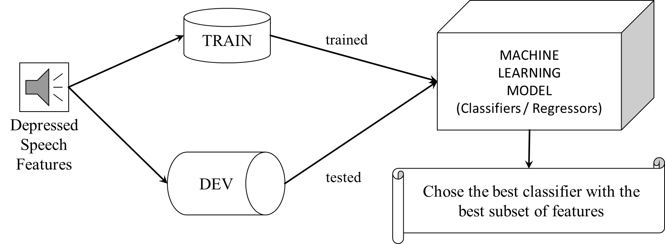
Method
7
Process
Selecting and Understanding Dataset
Audio Features Extraction
Data Preparation
Model Training
Result Comparison and Analysis
Audio Pre-processing
Notes:
To achieve that, we conduct a series of experiments. Firstly, we would need to first understand the dataset from AVEC2016, preprocess the audio, extract audio features, prepare the data, train the model and then analyze the result.
The data is split into train and dev set from the AVEC 2016, we train the model using train data and test them using dev data. Different learning models are compared using mean F1 and RMSE.

Slide 9
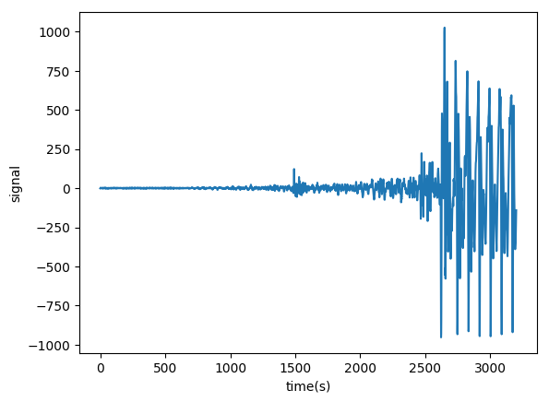
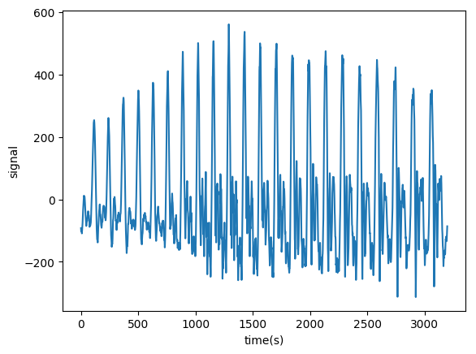

Understanding Dataset
8
Non-depressed Sample
Depressed Sample
Notes:
The data provided in the AVEC 2016 (Audio-visual emotion challenge) is from DAIC-WOZ Depression Database. It contains clinical interviews designed to support the diagnosis of psychological distress conditions such as anxiety, depression, and post-traumatic stress disorder. We can find raw audio data and video features inside the dataset. The data provided is based on the PHQ-8. Let’s listen to one of the audio segment. It’s a type of interview. As shown in the slide, depressed speech is more flat, thus is really possible to be detected using speech.

Slide 10
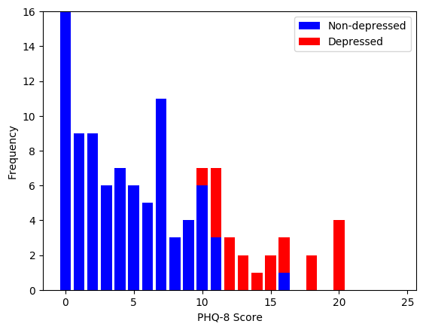
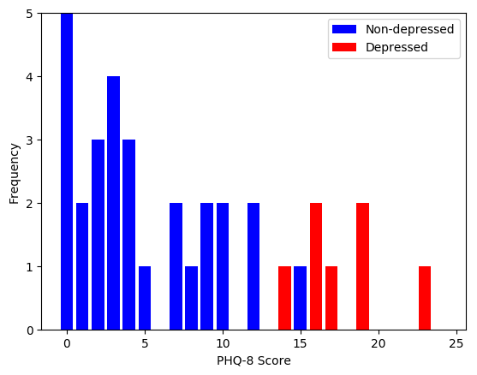
Understanding Dataset
9
Train Set
Dev Set
Notes:
Next, we can take a look on the histogram. It shows the distribution of the data over each score. As you can see the distribution of phq-8 still cannot be like the image produced by computer yet.

Slide 11
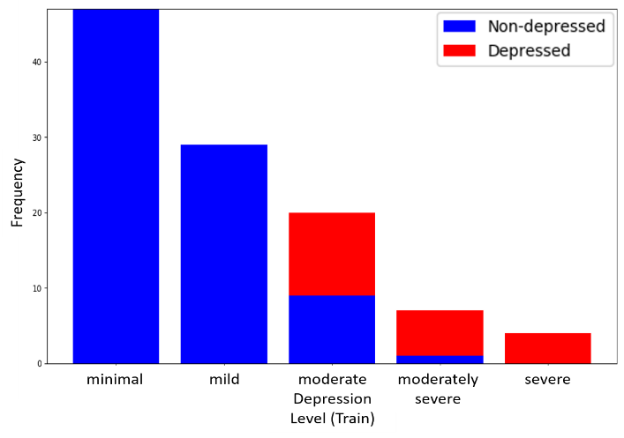
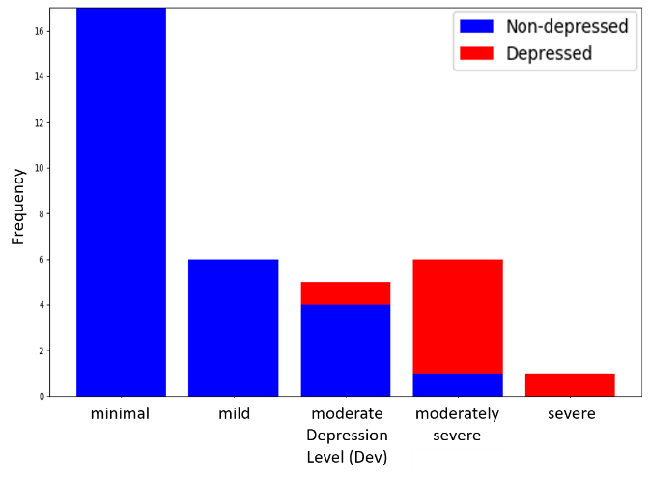
Understanding Dataset
10
Train Set
Dev Set
Notes:
It shows the distribution of the data over depression level. While depression level still could not imply if a person has depression or not, we could provide an objective measure or a warning to the person is being diagnosed.

Slide 12
Audio Pre-Processing
11
Obtain original raw audio.
Noise Reduction using FFMPEG and SOX.
Obtain Speech Segments using transcript.
Merge them into one audio.
Start time | Stop time | Speaker | Value
60.0 | 61.3 | Ellie | How are you doing today?
62.3 | 63.2 | Participant | Good.
Notes:
After obtaining the data, we would need to preprocess the audio. This is the original audio, as you can hear, there are a lot of noisy voice and contains other person’s speech. Thus, we use FFMPEG and SOX to reduce the noice.
Then, we obtain speech segments using the transcript they provide.
After that, we merge them into one audio.

Slide 13
Audio Features Extraction
12
Index | Audio Feature Name | Description
1 | Zero Crossing Rate | The rate of sign-changes of the signal during the duration of a particular frame.
2 | Energy | The sum of squares of the signal values, normalized by the respective frame length.
3 | Entropy of Energy | The entropy of sub-frames’ normalized energies, it can be interpreted as a measure of abrupt changes.
4 | Spectral Centroid | The center of gravity of the spectrum.
5 | Spectral Spread | The second central moment of the spectrum.
6 | Spectral Entropy | Entropy of the normalized spectral energies for a set of sub-frames.
7 | Spectral Flux | The squared difference between the normalized magnitudes of the spectra of the two successive frames.
8 | Spectral Rolloff | The frequency below which 90% of the magnitude distribution of the spectrum is concentrated.
9~21 | MFCCs | Mel Frequency Cepstral Coefficients form a cepstral representation where the frequency bands are not linear but distributed according to the mel-scale.
22~33 | Chroma Vector | A 12-element representation of the spectral energy where the bins represent the 12 equal-tempered pitch classes of western-type music (semitone spacing).
34 | Chroma Deviation | The std of the 12 Chroma coefficients.
Notes:
Well in order to perform machine learning we need to extract some audio feature from the speech to represent some features of what we hear in our ear.
We make use of a python library named pyAudioAnalysis to extract these audio features. Note that Audio Features and Features are different. Audio Features are the sets which contain features. Features belong to the Audio Sets.

Slide 14
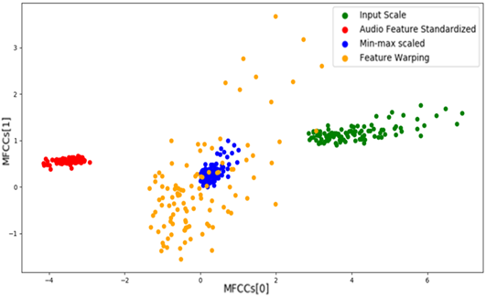
Data Preparation (Normalization)
13
We propose: Audio Feature Standardization
Notes:
There are 2 normalization methods being used in the depression community which are Min-max scaled and Feature Warping. Feature Warping changes the distribution of the data, in this case, to normal distribution (0 mean), min-max scaled is used by many related studies such as MITLL, the idea is to scale the data from a minimum to maximum. Audio Feature Standardization is something similar to Feature Warping, except that it treats audio features as a unit instead of treating every features individually.

Slide 15
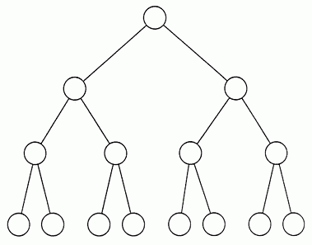
Data Preparation (Feature Selection)
14
We propose Audio Feature Selection via Complete Search
We examined Relief, Fisher, CIFE, CMIM, MRMR, MIFS, ICAP, FCBF, CFS and GINI.
Notes:
The main feature selection method that we tried is Audio Feature Selection via Complete Search. It exhaustively search for the best audio feature set.
Other sophiscated feature selection methods include Relief, Fisher, CIFE, CMIM, MRMR, MIFS, ICAP, FCBF, CFS and GINI. We propose Audio Feature Selection via Complete Search because these methods treat every features individually but not viewing the audio feature as a unit. However, we still use them, because they might be useful for us to identify redundant features.

Slide 16
Model Training
15
Names | Description
Naïve Bayes (NB) | NB estimates based on the assumption that all features are independent with each other.
Gaussian Process (GP) | GP focuses on stochastic processes which generalize the probability distribution for functions.
Support Vector Machine (SVM) | SVM tries to maximize the linear margin between the two separating hyperplane and thus focus on creating the largest possible distance between the two hyperplanes.
K-Nearest Neighbours (KNN) | KNN is constructed based on the assumption of all the similar data will generally exist closer to each other.
Decision Tree (DT) | DT contains a decision tree which performs the classification task by sorting them based on feature values.
Random Forest (RF) | RF is an ensemble of decision trees trained with different subsets of the training examples.
AdaBoost (AB) | AB is an ensemble of learners with different hypothesis by making changes to training examples. It maintains a set of weights over the learners.
Notes:
These are the models that are examined. They are quite standard and famous. RF is the baseline model, DT is used by pampouchidou. GP is used by MITLL.

Slide 17
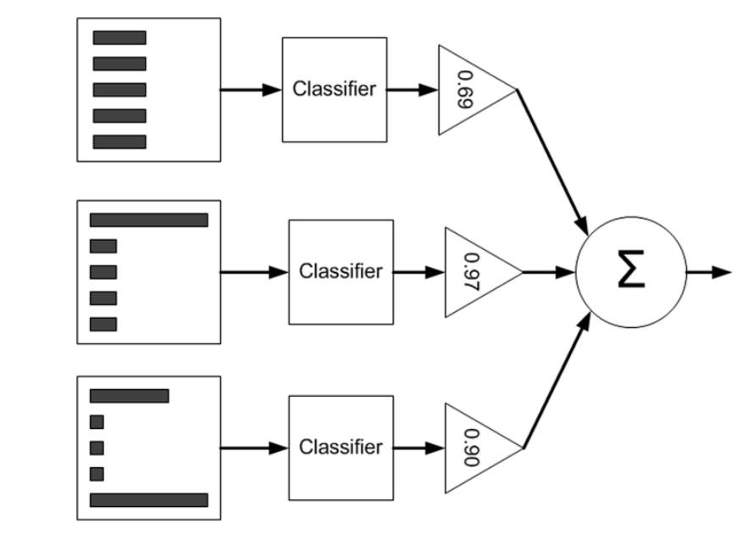
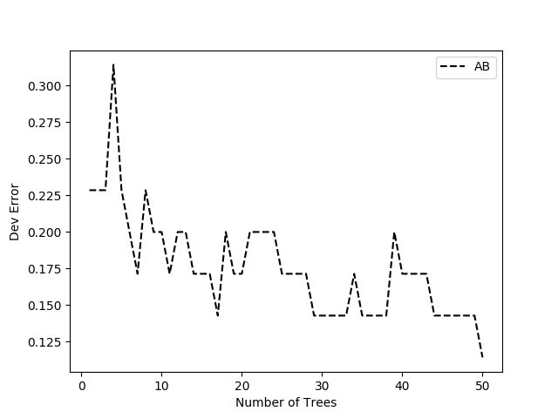
Model Training
16
AdaBoost (AB)
Notes:
The model that we choose to use is AdaBoost, it is a type of ensemble that predicts based of the sum of weighted score of its classifiers. Because we have limited dataset, AB is an extremely strong model which it reduces the risk of choosing the wrong hypothesis, better estimates the correct hypothesis and has a larger possible space of representable hypothesis given a finite dataset. The right graph showing the strength of boosting.

Slide 18
Result (Normalization)
17
Effects of Audio Feature Standardization
Audio Features | F1 Score (Without Normalization) | Classifier | F1 (With Audio Feature Standardization) | Classifier
Zero-Crossing Rate | 0 (0.89) | GP-DP | 0 (0.89) | GP-DP
Energy | 0 (0.89) | GP-DP | 0 (0.89) | GP-DP
Entropy of Energy | 0 (0.89) | GP-DP | 0.36 (0.88) | AB
Spectral Centroid | 0.18 (0.85) | AB | 0 (0.89) | GP-DP
Spectral Spread | 0.18 (0.85) | AB | 0.14 (0.78) | AB
Spectral Entropy | 0 (0.89) | GP-DP | 0.25 (0.78) | AB
Spectral Flux | 0.33 (0.86) | AB | 0.25 (0.90) | KNN
Spectral Rolloff | 0 (0.89) | GP-DP | 0 (0.89) | GP-DP
MFCCs | 0.2 (0.87) | AB | 0.36 (0.88) | AB
Chroma Vector | 0.2 (0.87) | AB | 0.25 (0.90) | GP-DP
Chroma Deviation | 0 (0.89) | GP-DP | 0.13 (0.76) | AB
Notes:
These are the effect of Audio Feature Standardization on each individual audio features.

Slide 19
Result (Binary Classification)
18
Audio Features | Model | Mean F1 | F1
Mean of Zero-crossing Rate, Entropy of Energy, Spectral Spread, Spectral Entropy, MFCCs, Chroma Deviation | AB | 0.82 | 0.71 (0.93)
Normalized Mean of Spectral Centroid, Spectral Entropy, Spectral Rolloff, MFCCs, Chroma Vector, Chroma Deviation | AB | 0.77 | 0.6 (0.93)
Mean and Std of Spectral Centroid, Spectral Spread, Spectral Flux | AB | 0.80 | 0.67 (0.93)
Normalized Mean and Std of Entropy of Energy, Spectral Centroid, Spectral Spread, Spectral Flux | AB | 0.70 | 0.53 (0.87)
Notes:
As shown in the result, Mean of Zero-crossing Rate, Entropy of Energy, Spectral Spread, Spectral Entropy, MFCCs, Chroma Deviation are the optimal audio feature set. ZCR, Entropy of Energy, Spectral Spread, Spectral Entropy, Chroma Deviation are all related to the variation of the speech. As we mentioned just now, variation is the key, thus, these features are the best. MFCCs are also included because they best approximate human ears.

Slide 20
Result (Audio Classification Comparison)
19
Related Study | Model | Audio Features | Normalization | Optimization | Mean F1
Proposed Method | AB | Mean of Zero-crossing Rate, Entropy of Energy, Spectral Spread, Spectral Entropy, MFCCs, Chroma Deviation | None | None | 0.82
Baseline | Linear SVM with SGD | F0, VUV, NAQ, QOQ, H1H2, PSP, MDQ, peak-Slope, Rd, MCEP0-24, HMPDM0-24, HMPDD0-12 | None | Grid Search for hyper-parameter optimization | 0.50
DepAudioNet | CNN and LSTM | Mel-scale filter bank feature | Batch Normalization | Random Sampling | 0.61
MITLL | Gaussian Staircase Model | Correlation structure of formant tracks, Correlation structure of dMFCCs, Lower Vocal Tract (VT) Resonance Pattern, peak-to-rms | Min-max Scaling | Z-scoring, PCA | 0.57
Pampouchidou | Decision Fusion Model which is implemented using DT | Baseline, Rd conf, Formants 1-3, the deltas & delta-deltas for F0 & MFCCs, Pause Ratio, Voiced Segment Ratio, Speaking Ratio, Mean Laughter Duration, Mean Delay to answer question, Mean Duration of Pauses, Max Duration of Pauses & Fraction of overall pauses | Min-max Scaling | Feature Selection accesses based on the improvement of modal by removing features. | 0.73
SCUBA | G-PLDA | Ivector (MFCC) | None | MIM | 0.73
Notes:
This is the comparison of our proposed method and related studies.

Slide 21
Result (Binary Classification Comparison)
20
Related Study | Modality | F1 | Mean F1
Proposed Method (AB) | Audio | 0.71 (0.93) | 0.82
Baseline | Audio | 0.41 (0.58) | 0.50
Baseline | Audio-Video | 0.58 (0.86) | 0.72
DepAudioNet | Audio | 0.52 (0.70) | 0.61
MITLL | Audio | - | 0.57
MITLL | Audio-Video-Semantic | - | 0.81
Pampouchidou | Audio-Gender | 0.59 (0.87) | 0.73
Pampouchidou | Audio-Video-Text-Gender | 0.62 (0.91) | 0.77
SCUBA | Audio | 0.57 (0.89) | 0.73
SCUBA | Audio-Video | 0.63 (0.89) | 0.76
Notes:
This is the result of our proposed model compared to other related studies in binary classification.

Slide 22
Result (Regression Comparison)
21
Related Study | Modality | RMSE | MAE
Proposed Method (AB) | Audio | 6.43 | 5.32
Baseline | Audio | 6.7418 | 5.3566
Baseline | Audio-Video | 6.6212 | 5.5222
MITLL | Audio | 6.38 | 5.32
MITLL | Audio-Video-Semantic | 5.31 | 4.18
SCUBA | Audio | 6.7334 | 5.8237
Notes:
This is the result of our proposed model compared to other related studies in regression. Why our model gives the best classification result but not regression result. Our hypothesis is that people are more inclined to do the assessment truthfully thus the score might not be very accurate, however, depression level is more accurate.

Slide 23
Result (Summary of All Tasks)
22
Tasks | Baseline | Best (Audio) | Best (All) | Proposed Result
Binary Classification | Mean F1 of 0.5 | Mean F1 of 0.73 | Mean F1 of 0.81 | Mean F1 of 0.82
Regression | RMSE of 6.74 | RMSE of 6.38 | RMSE of 5.31 | RMSE of 6.43
Multi-class Classification | None | None | None | Mean F1 of 1
Notes:
In summary, this is what we achieved

Slide 24
Contribution
23
AB trained by Mean of Zero-crossing Rate, Entropy of Energy, Spectral Spread, Spectral Entropy, MFCCs, Chroma Deviation provides mean F1 of 0.82 and RMSE of 6.43.
In multi-class classification, AB gives mean F1 of 1.
The optimal Audio Feature Set is chosen using Audio Feature Selection via Complete Search.
Audio Feature Standardization should be used with care.
Notes:
In conclusion, to provide an objective measure for depression diagnosis, we try out different methods to improve the accuracy of audio model. AB trained by Mean of Zero-crossing Rate, Entropy of Energy, Spectral Spread, Spectral Entropy, MFCCs, Chroma Deviation provides mean F1 of 0.82 and RMSE of 6.43. It is a great improvement of audio classifiers but slight improvement to classifiers that include various features, hinting us that maybe we should try out more different features.
However, AB did well in the multi-class classification by giving mean F1 of 1. The optimal audio feature set is chosen using exhaustive search
On the other hand, Audio Feature Standardization should be used with care.

Slide 25

Q&A
Thank You!

Slide 26
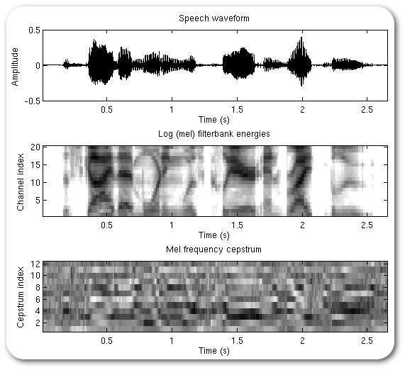
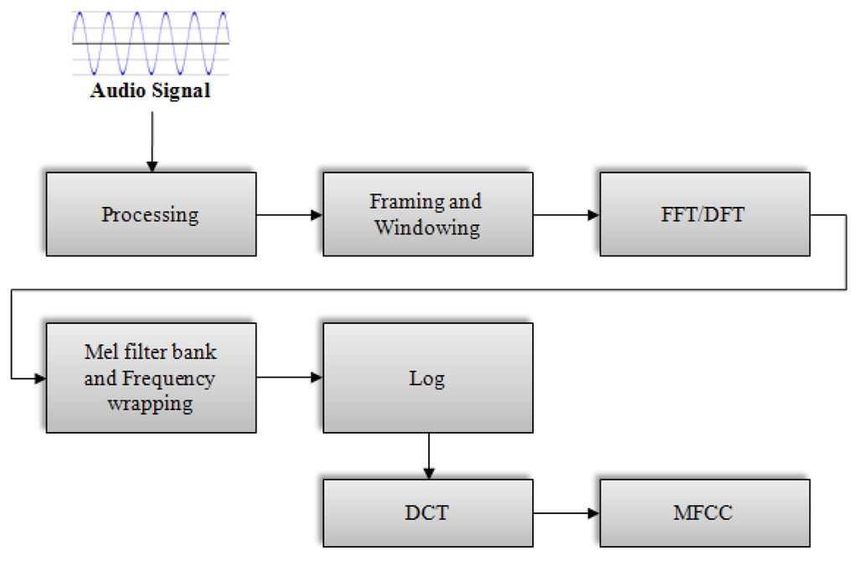
Hidden (MFCC Algorithm)

